Slide 1
Criminal Activity and Weather Analysis in Los Angeles
Akash Vaidya, Melody Liou, Simar Singh, Srinivas Hanumansetty

Slide 2
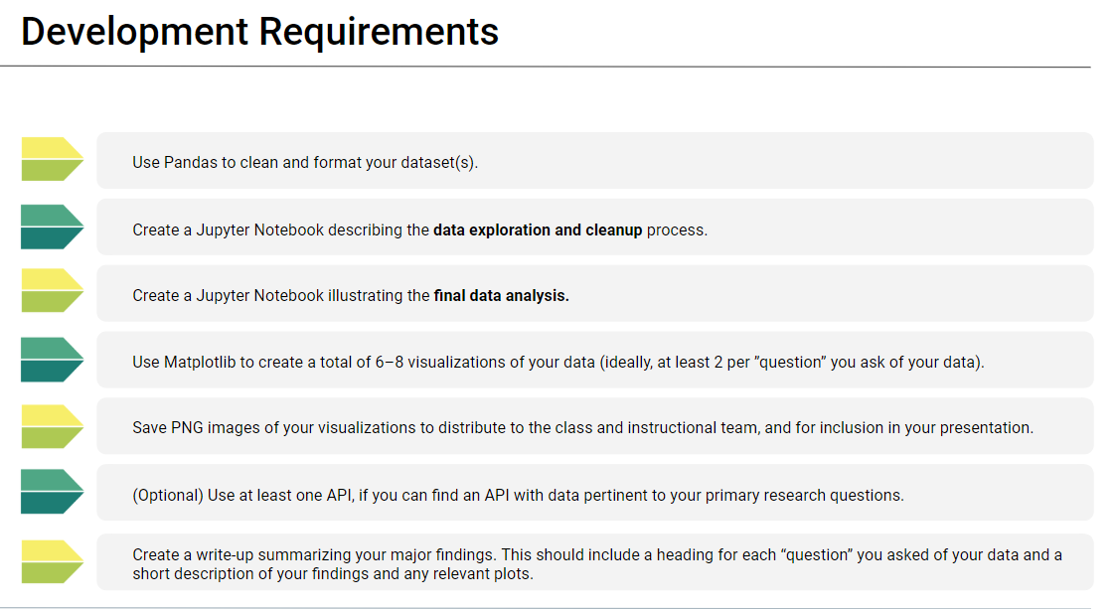

Slide 3
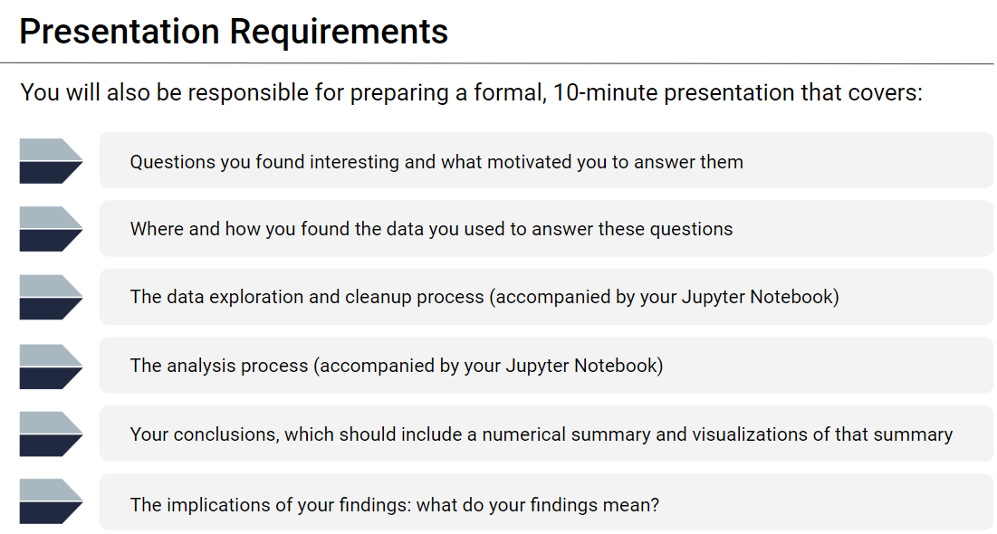

Slide 4
Project Description/Outline
Use aggregate crime data from different police precincts in a city to uncover patterns in criminal activity.
i.e. Most crimes LA takes place during the summer. Can you uncover similar patterns in your city?
What do your results suggest about how police should plan their patrols?
What do your results suggest about how best to distribute law enforcement resources over the calendar year?

Slide 5
Research Questions to Answer:
Do crimes occur more during spring, summer, fall, or winter (throughout the year/each months/etc.)?
What do your results suggest about how police should plan their patrols?
What do your results suggest about how best to distribute law enforcement resources over the calendar year?
Others: Data visualization of crimes arrest/weather

Slide 6
Data Sets to be Used (Website Links Resources):
Crimes in Los Angeles from 2010 to September 2017 [https://www.kaggle.com/cityofLA/crime-in-los-angeles]
Arrest data from 2010 to most present [https://data.lacity.org/A-Safe-City/Arrest-Data-from-2010-to-Present/yru6-6re4]
LA City Data Main Page [https://data.lacity.org/]
Weather API [https://openweathermap.org/api]
Historical Weather API [https://api.meteostat.net/]

Slide 7
Breakdown of the Assigned Tasks
Understanding the Dataset
Data Cleaning
Data Visualization (matplotlib, bar plot, pie plot, line plot, etc.)
Data Analysis and conclusions that answer our questions
Data PowerPoint presentation

Slide 8
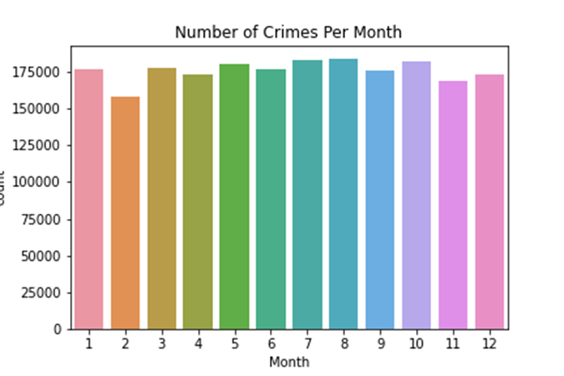
Weather Patterns/Crime Data Analysis
Question: In the calendar period, does the weather pattern correspond with the criminal activity occurring in the city of Los Angeles?
Initial Analysis of Numbers of Crimes Per Month:
In the first quarter of the year, Month 2 (February) has the lowest number of reported crimes in the year.
From Month 3 (March) to Month 8 (August), there is an increase in the reported crimes.
In the fourth quarter, there is a significant decrease in the reported crimes in comparison to the rest of the year.

Slide 9
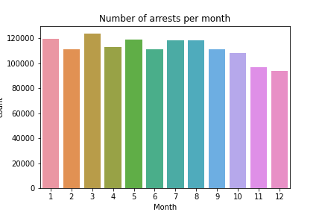
Weather Patterns/Crime Data Analysis
Initial Analysis of Numbers of arrest per month:
There is an overall decrease in the number of reported arrests starting from month 9 (September) to the end of the year.
The highest number of reported arrests peak in the first quarter of the year. Please reference Month 1 (January) and Month 3 (March). In addition, please note that there is a significant drop in reported arrests in Month 2 (February).
In the third quarter of the year, the pattern of arrests remains relatively stable. Please reference Month 7 (July) to Month 8 (August).
In comparison to the number of reported crimes, the number of reported arrests in the Month 11 (November) and Month 12 (December) remain low.

Slide 10
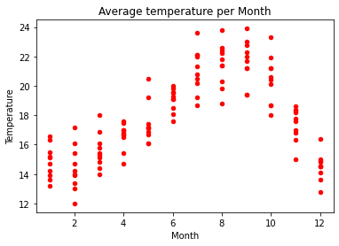
Weather Patterns/Crime Data Analysis
Initial Analysis of Numbers of Temperature per month:
The temperature range from start of Quarter 1 and end of Quarter 4 are in similar range. Please note that the reported arrests/crimes are higher in Quarter 1 than in Quarter 4.
From Month 3 (March) to Month 9 (August), there is a gradual increase in the temperature.
In the third quarter of the year, the temperature peaks. Please note that patterns of reported arrests/crimes similarly peak in the third quarter. Please reference Month 7 (July) to Month 8 (August).
The number of reported crimes/arrests in Quarter 1 is in similar range to that of Quarter 4, despite Quarter 1 reporting lower temperatures.

Slide 11
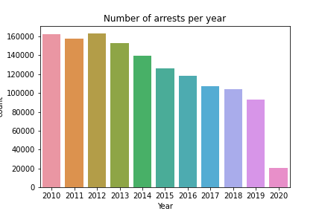
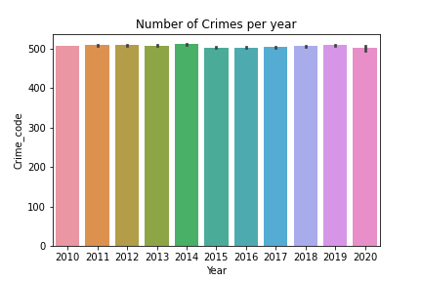
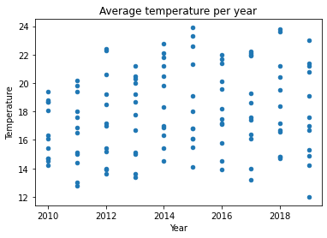
Weather Patterns/Crime Data Analysis
Question: What were other relevant pieces of data visualization for weather patterns and crime data?
Initial Analysis of 2010 to 2019 of reported crimes/arrests and temperature
From 2010 to 2019, there is a gradual decrease in the number of arrests reported.
From 2010 to 2015, there is an overall increase in the average temperature.
There were peaks in the average temperature in 2015 and 2018.

Slide 12
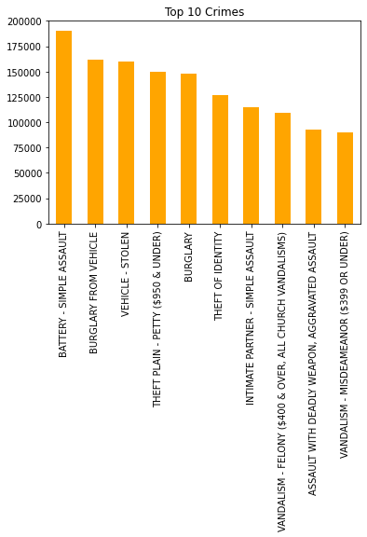
Law Enforcement Redistribution Analysis
Question: How should the Los Angeles Police Department plan their patrols/allocate resources?
Initial Analysis of the Top Ten (10) crimes:
The most reported crime is Battery – Simple Assault.
The least reported crime is Vandalism – Misdemeanor ($399 OR UNDER).
A majority of the crimes reported is in relation to theft.

Slide 13
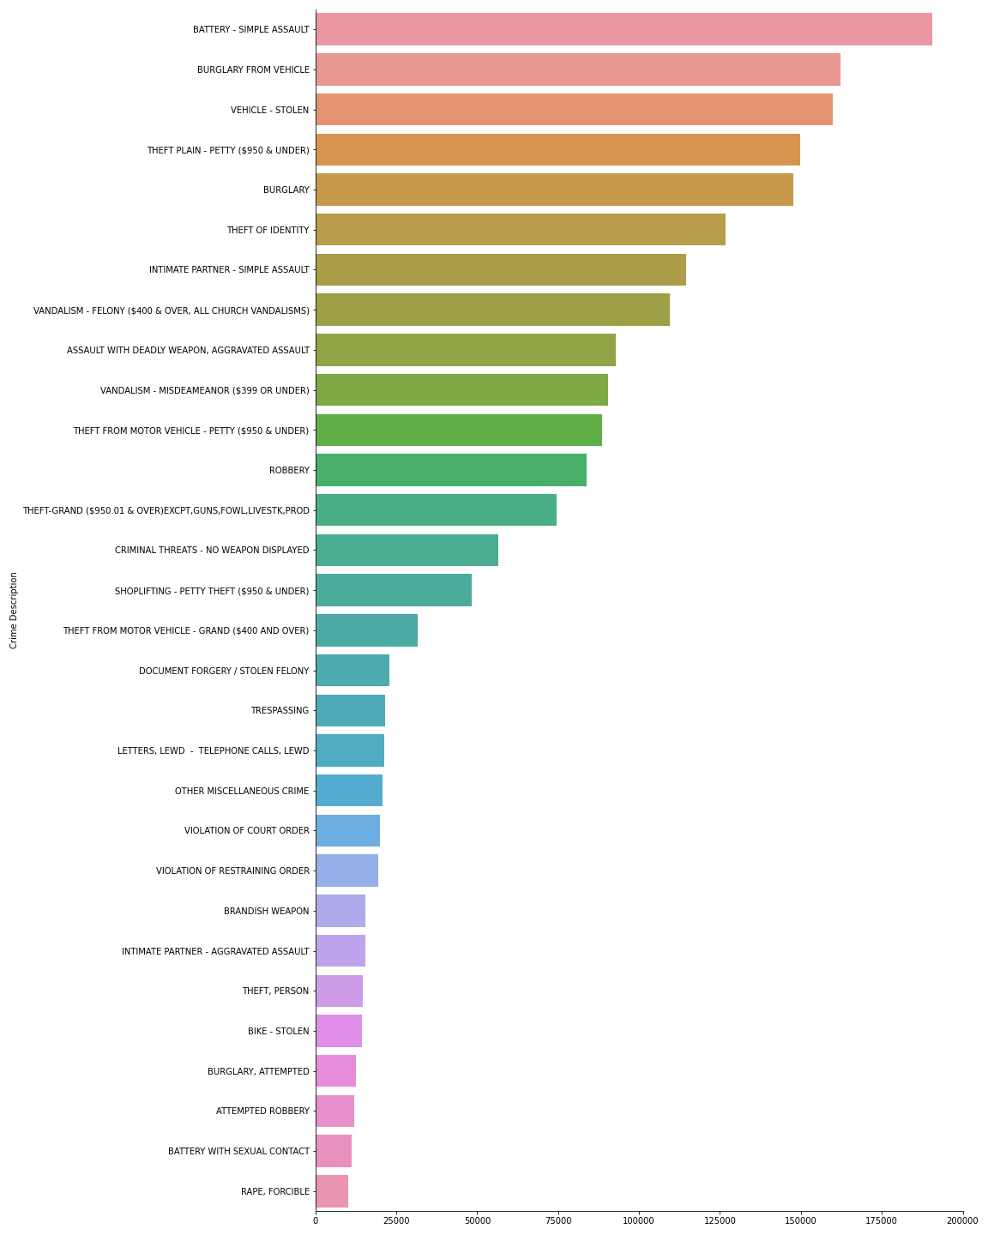
Law Enforcement Redistribution Analysis
Initial Analysis of overall reported crimes:
The least reported crime categories are in relation to sexual assault.
The most overall reported crime category is in relation to theft/robbery. The categories range from vehicle-related theft to burglary.
The 2nd most overall crime category is in relation to assault. The categories range from assault with a deadly weapon to battery.

Slide 14
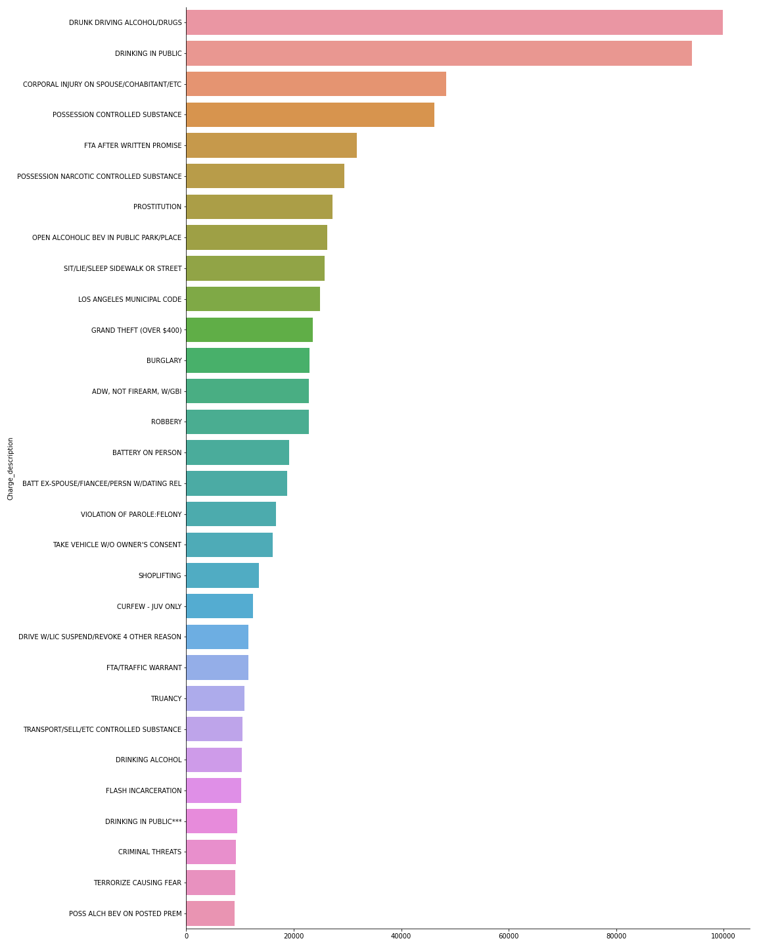
Law Enforcement Redistribution Analysis
Additional crime datasets that were reviewed.

Slide 15
Conclusion
Question: In the calendar period, does the weather pattern correspond with the criminal activity occurring in the city of Los Angeles?
Findings:
Based on the data reviewed, there is significant evidence to support correlation weather patterns and the reported crime data.
From Month 3 (March) to Month 8/9 (August/September), there is an increase in the reported crime data and temperature.
In the fourth quarter, there is a decrease in the reported crime data and temperature.
It was noted in the first quarter that the reported crime data was higher than fourth quarter, despite similar temperature ranges.
The seasons of Spring and Summer had the most activity of reported crime data.
Question: How should the Los Angeles Police Department plan their patrols/allocate resources?
Findings:
Based on the data reviewed, we identified the most common crimes reported in the Los Angeles area.
the most reported crime category was Battery – Simple Assault.
In the Top Ten (10) crimes, the most common reported crime was in relation to theft.
The most common crime category was in relation to theft. The categories range from vehicle-related theft to burglary.
Question: What were other relevant pieces of data visualization for weather patterns and crime data?
Findings:
We reviewed 2010 to 2019 datasets for year by year patterns.
From 2010 to 2019, there is a gradual decrease in the number of arrests reported.
From 2010 to 2015, there is an overall increase in the average temperature.

Slide 16
Conclusion
Question: What do your results suggest about how best to distribute law enforcement resources over the calendar year?
Recommendations:
We recommend the Los Angeles Police Department to increase law enforcement resources in the season of Summer and Spring as the data reviewed established correlation between the weather pattern and reported criminal activity.
We recommend the Los Angeles Police Department to allocates additional resources to respond to theft and assault. For example, an increase in police patrol, during the peak months of July and August, in residential and commercial areas would be necessary to respond to vehicle–related theft.
In Month 1 (January) and Month 3 (March), crime data revealed significant criminal activity despite reported lower temperatures. We recommend additional law enforcement resources be distributed for the reported period.

Slide 17

Questions?

